Slide 1
CE331A Coordinate Transformation
Ibaad Anwar
Ashish Katiyar

Slide 2
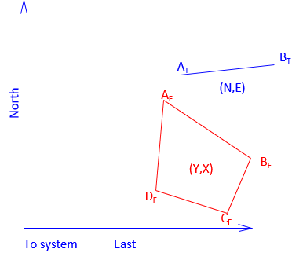
Transforming Coordinates
A coordinate transformation changes point positions from one coordinate system to another
Points A_{T} and B_{T} are the points correctly located in the To system.
Points A_{F} and B_{F} are the same points but in a the From system.
Points C_{F} and D_{F} are also in the From system and we would like to know their coordinates in the To system.

Slide 3
Transformation elements
Scaling
Rotation
Translation
Scaling is used to increase or decrease distances between the points in order to make them fit in the new system.
The From coordinates must be rotated to make its directions coincide with those of the To system
The final element consists of two translations: shift positions in the North-South and East-West directions

Slide 4
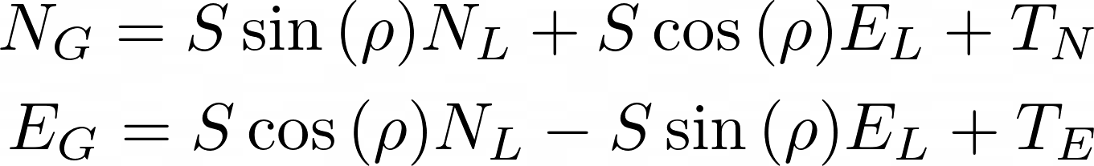
Transformation equation
N_{G}, E_{G} are Global system coordinates
N_{L}, E_{L} are To system coordinates
T_{E}, & T_{N} are the translations in East and North directions
ρ is the rotation angle
S is the scale

Slide 5
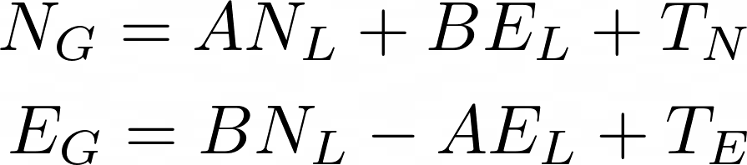


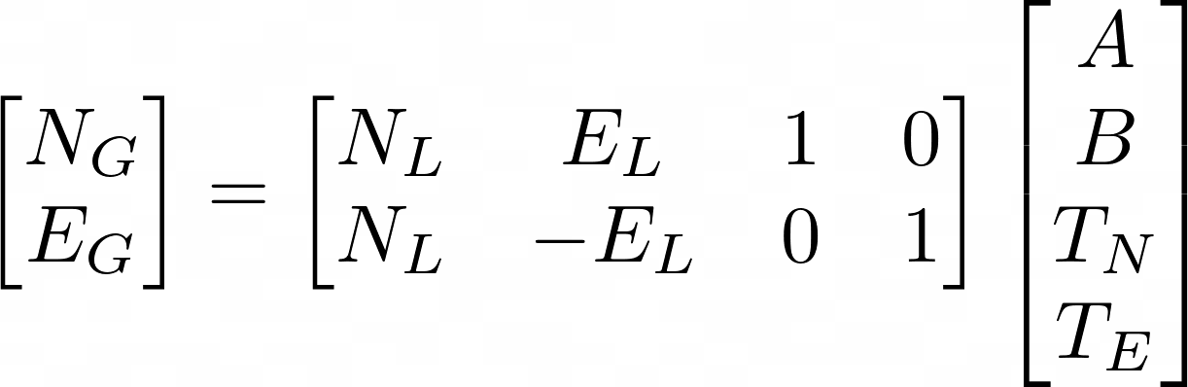

Transformation equation can be written as :
Where,
Transformation Equation in matrix form can be written as :

Slide 6

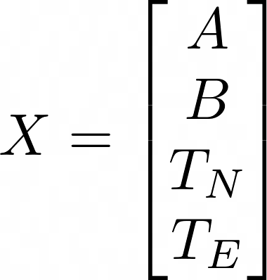
Number of unknown = 4,
Number of equation from one point = 2
At least two point is required to get the solution
For redundant scenario, use least squares solution
Solution :
After getting X, one can estimate the other coordinate

